Slide 1
Chapter 1: Introduction
Purpose of Database Systems
View of Data
Data Models
Data Definition Language
Data Manipulation Language
Transaction Management
Storage Management
Database Administrator
Database Users
Overall System Structure

Slide 2
Database Management System (DBMS)
A database-management system (DBMS) is a collection of interrelated data (database) and a set of programs to access those data.
Database contains information relevant to a particular enterprise
DBMS provides an environment to store and retrieve database information that is both convenient and efficient to use.
1.1 Database -system Applications:
Enterprise information: sales, accounting, human resources, manufacturing, online retailers
- Sales: customers, products, purchases
- Manufacturing: production, inventory, orders, supply chain
- Human resources: employee records, salaries, tax deductions
Banking and Finance: banking, credit card transactions, finance
Airlines: reservations, schedule information
Universities: student information, course registration, and grades
Telecommunication: records of calls made, generating monthly bills, maintaining balances on prepaid calling cards, and storing information about the communication networks

Slide 3
1.2 Purpose of Database Systems
In the early days, database applications were built on top of file systems
Drawbacks of using file systems to store data:
Data redundancy and inconsistency
Multiple file formats, duplication of information in different files
Difficulty in accessing data
Need to write a new program to carry out each new task
Data isolation — data is scattered in various files.multiple files and formats
Integrity problems
consistency constraints (e.g. account balance > 0) become part of program code
Hard to add new constraints or change existing ones

Slide 4
1.2 Purpose of Database Systems (Cont.)
Drawbacks of using file systems (cont.)
Atomicity problems
Failures may leave database in an inconsistent state with partial updates carried out
E.g. transfer of funds from one account to another should either complete or not happen at all
Concurrent access anomalies by multiple users
Concurrent access allowed for multiple users for the sake of overall performance of the system and faster response
Uncontrolled concurrent accesses can lead to inconsistencies
E.g. two people reading a balance and updating it at the same time
Security problems
For all the users, access to the database system is restricted. Since application programs are added to the file-processing system in an ad hoc manner, enforcing such security constraints is difficult.
Database systems offer solutions to all the above problems

Slide 5
1.3 View of Data
A major purpose of a database system is to provide users with an abstract view of the data.
That is, the system hides certain details of how the data are stored and maintained.
1.3.1 Data Abstraction
• Physical level. The lowest level of abstraction describes how the data are actually stored. This level describes complex low-level data structures in detail.
• Logical level. The next-higher level of abstraction describes what data are stored in the database, and what relationships exist among those data. This level describes the entire database in terms of a small number of relatively simple structures.
The user of the logical level does not need to be aware of the complex physical-level structures complexity, which is referred as physical data independence.
• View level. The highest level of abstraction describes only part of the entire
database. The view level of abstraction exists to simplify the users interaction with the system. The system may provide many views for the same database.

Slide 6
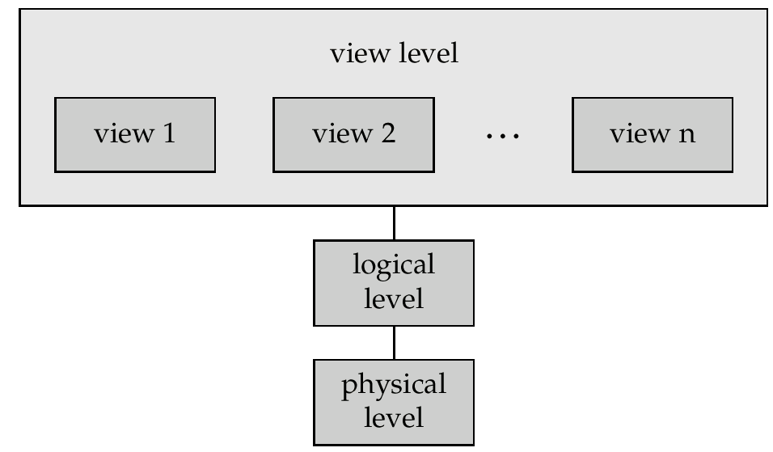
View of Data
Figure: The relationship among the three levels of data abstraction

Slide 7
Levels of Abstraction
Example: type customer = record name : string; street : string; city : integer; end;
Physical level describes a block of consecutive storage locations for the customer record.
Logical level: each record is described be a type definition, and interrelationship of these record types is defined as well.
View level: users see a set of application programs hide details of the data types. Views can also hide information (e.g., salary) for security purposes.

Slide 8
1.3.2 Instances and Schemas
Similar to types and variables in programming languages
Schema – the logical structure of the database
e.g., the database consists of information about a set of customers and accounts and the relationship between them)
Analogous to type information of a variable in a program
Physical schema: database design at the physical level
Logical schema: database design at the logical level
Instance – the actual content of the database at a particular point in time
Analogous to the value of a variable

Slide 9
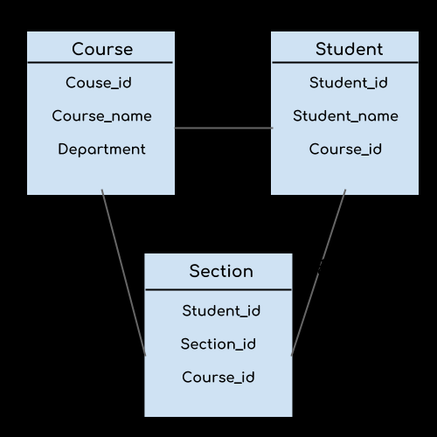
SCHEMA-Eg.,

Slide 10
Evolution of Data Models
A data model is a collection of tools for describing
data
data relationships
data semantics
consistency constraints
A data model provides a way to describe the design of a database at the physical, logical, and view levels.
4 categories are,
(1) Relational model (uses a collection of tables to represent both data and the relationships among those data. Each table has multiple columns, and each column has a unique name. Tables are also known as relations.)
(2) Entity-Relationship model (uses a collection of basic objects, called entities, and relationships among these objects.)
(3) Object-based data model
(4) Semi-structured data model (permits the specification of data where individual data items of the same type may have different sets of attributes.)
Older models: network model and hierarchical Model
- These models were tied closely to the underlying implementation, and complicated the task of modeling data. As a result they are used little now.

Slide 11
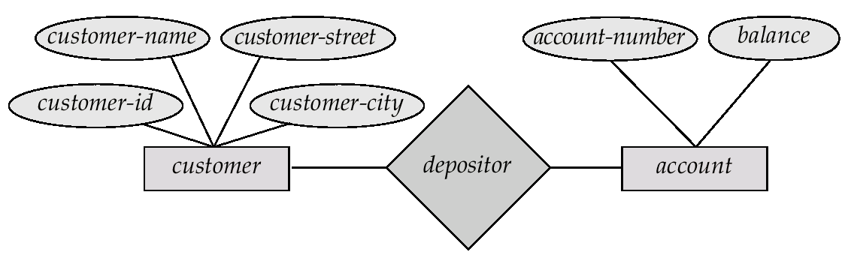
Entity-Relationship Model
Example of schema in the entity-relationship model

Slide 12
Entity Relationship Model (Cont.)
E-R model of real world
Entities (objects)
E.g. customers, accounts, bank branch
Relationships between entities
E.g. Account A-101 is held by customer Johnson
Relationship set depositor associates customers with accounts
Widely used for database design
Database design in E-R model usually converted to design in the relational model (coming up next) which is used for storage and processing

Slide 13
Relational Model
Attributes
Example of tabular data in the relational model
Customer-id
customer-
name
customer-
street
customer-
city
account-
number
192-83-7465
019-28-3746
192-83-7465
321-12-3123
019-28-3746
Johnson
Smith
Johnson
Jones
Smith
Alma
North
Alma
Main
North
Palo Alto
Rye
Palo Alto
Harrison
Rye
A-101
A-215
A-201
A-217
A-201

Slide 14
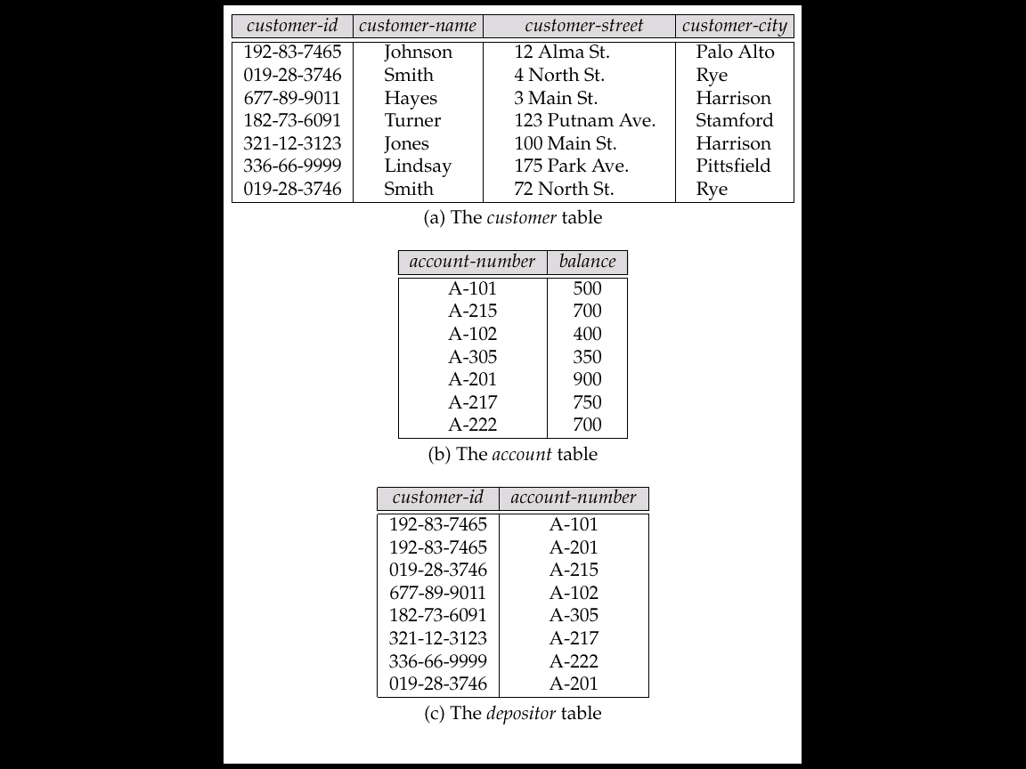
A Sample Relational Database

Slide 15
Data Definition Language (DDL)
Specification notation for defining the database schema
E.g. create table account ( account-number char(10), balance integer)
DDL compiler generates a set of tables stored in a data dictionary
Data dictionary contains metadata (i.e., data about data)
database schema
Data storage and definition language
language in which the storage structure and access methods used by the database system are specified
Usually an extension of the data definition language

Slide 16
Data Manipulation Language (DML)
Language for accessing and manipulating the data organized by the appropriate data model
DML also known as query language
Two classes of languages
Procedural – user specifies what data is required and how to get those data
Nonprocedural – user specifies what data is required without specifying how to get those data
SQL is the most widely used query language

Slide 17
Database Architecture
Database systems can be centralized, or client-server, where one server machine executes work on behalf of multiple client machines.
Database systems can also be designed to exploit parallel computer architectures. Distributed databases span multiple geographically separated machines.
Database applications are usually partitioned into two or three parts, as in Figure 1.6.
In a two-tier architecture, the application resides at the client machine, where it invokes database system functionality at the server machine through query language statements.
- Application program interface standards like ODBC and JDBC are used for interaction between the client and the server.
In a three-tier architecture, the client machine acts as a front end and does not contain any direct database calls.
- Instead, the client end communicates with an application server, usually through a forms interface. The application server in turn communicates with a database system to access data.
The business logic of the application, which says what actions to carry out under what conditions, is embedded in the application server, instead of being distributed across multiple clients.
Notes:
Three-tier applications are more appropriate for large applications, and for applications that run on the WorldWideWeb.

Slide 18
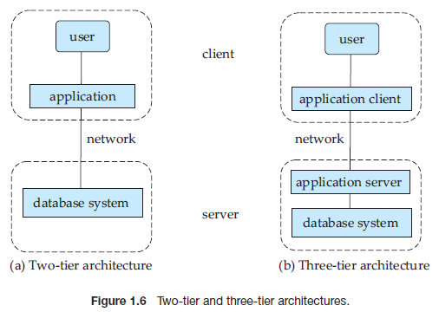
Two-tier and three-tier architectures
Two-tier architecture: Ex - client programs using ODBC/JDBC to communicate with a database
Three-tier architecture: Ex - web-based applications, and applications built using “middleware”

Slide 19
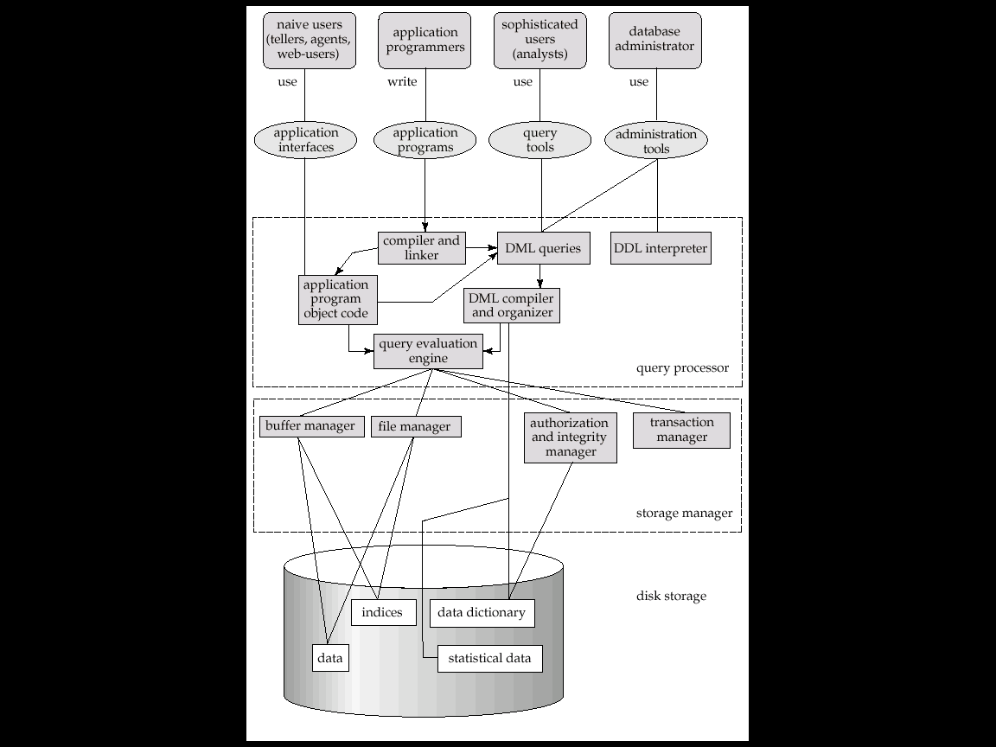
Overall System Structure

Slide 20
Database Users
A primary goal of a database system is to retrieve information from and store new information into the database.
database users and database administrators
Database Users and User Interfaces
(1) Naive users are unsophisticated users who interact with the system by invoking one of the application programs that have been written previously.
Ex: people accessing database over the web, bank tellers, clerical staff or simply read reports generated from the database.
(2) Application programmers are computer professionals who write application programs. They can choose from many tools to develop user interfaces.
Ex: Rapid application development (RAD) tools - used to construct forms and reports with minimal programming effort.
(3) Sophisticated users interact with the system without writing programs. They form their requests either using a database query language or by using tools such as data analysis software.
• (4) Specialized users are sophisticated users who write specialized database applications that do not fit into the traditional data-processing framework.
Ex: computer-aided design systems, knowledgebase and expert systems, systems that store data with complex data types (graphics data and audio data), and environment-modeling systems.

Slide 21
Database Administrator
A person who has central control of both the data and the programs that access those data over the system is called a database administrator (DBA).
The functions of a DBA include:
• Schema definition: The DBA creates the original database schema by executing a set of data definition statements in the DDL.
• Storage structure and access-method definition
• Schema and physical-organization modification: The DBA carries out changes to the schema and physical organization to reflect the changing needs of the organization, or to alter the physical organization to improve performance.
• Granting of authorization for data access: the database administrator can regulate which parts of the database various users can access. The authorization information is kept in a special system structure.
• Routine maintenance. Examples of the database administrator’s routine maintenance activities are:
- Periodically backing up the database, either onto tapes or onto remote servers, to prevent loss of data in case of disasters such as flooding.
- Ensuring that enough free disk space is available for normal operations, and upgrading disk space as required.
- Monitoring jobs running on the database and ensuring that performance is not degraded by very expensive tasks submitted by some users.
Specifying integrity constraints
Acting as liaison with users
Monitoring performance and responding to changes in requirements

Slide 22
Data Storage and Querying
The functional components of a database system can be broadly divided into the storage manager and the query processor components.
Notes:
The storage manager is important because databases typically require a large
amount of storage space. Corporate databases range in size from hundreds of
gigabytes to, for the largest databases, terabytes of data. A gigabyte is approximately
1000 megabytes (actually 1024) (1 billion bytes), and a terabyte is 1 million
megabytes (1 trillion bytes). Since the main memory of computers cannot store
this much information, the information is stored on disks. Data are moved between
disk storage and main memory as needed. Since the movement of data
to and from disk is slow relative to the speed of the central processing unit, it is
imperative that the database system structure the data so as to minimize the need
to move data between disk and main memory.
The query processor is important because it helps the database system to
simplify and facilitate access to data. The query processor allows database users
to obtain good performance while being able to work at the view level and not be
burdened with understanding the physical-level details of the implementation of
the system. It is the job of the database system to translate updates and queries
written in a nonprocedural language, at the logical level, into an efficient sequence
of operations at the physical level.

Slide 23
Data Storage and Querying
(1) Storage Manager
It provides the interface between the low-level data stored in the database and the application programs and queries submitted to the system.
It is responsible for the interaction with the file manager.
The raw data are stored on the disk using the file system provided by the operating system.
It translates the various DML statements into low-level file-system commands.
Thus, it is responsible for storing, retrieving, and updating data in the database.

Slide 24
Data Storage and Querying
The storage manager components include:
• Authorization and integrity manager, which tests for the satisfaction of
integrity constraints and checks the authority of users to access data.
• Transaction manager, which ensures that the database remains in a consistent (correct) state despite system failures, and that concurrent transaction executions proceed without conflicting.
• File manager, which manages the allocation of space on disk storage and the data structures used to represent information stored on disk.
• Buffer manager, which is responsible for fetching data from disk storage into main memory, and deciding what data to cache in main memory.
- The buffer manager is a critical part of the database system, since it enables the database to handle data sizes that are much larger than the size of main memory.

Slide 25
Data Storage and Querying
The storage manager implements several data structures as part of the physical system implementation:
• Data files, which store the database itself.
• Data dictionary, which stores metadata about the structure of the database, in particular the schema of the database.
• Indices, which can provide fast access to data items.
- a database index provides pointers to those data items that hold a particular value. Ex: use an index to find the instructor record with a particular ID, or all instructor records with a particular name.
- Hashing is an alternative to indexing that is faster in some cases.

Slide 26
Data Storage and Querying
(2) The Query Processor
The query processor components include:
• DDL interpreter, which interprets DDL statements and records the definitions in the data dictionary.
• DML compiler, which translates DML statements in a query language into an evaluation plan consisting of low-level instructions that the query evaluation engine understands.
- A query can usually be translated into any of a number of alternative evaluation plans that all give the same result.
- The DML compiler also performs query optimization; that is, it picks the lowest cost evaluation plan from among the alternatives.
• Query evaluation engine, which executes low-level instructions generated by the DML compiler.

Slide 27
Data Independence
Logical Data Independence:
The ability to change the logical schema without changing the external schema or application programs is called as Logical Data Independence.
OR
The ability to change the logical schema without having to change the external schema.

Slide 28
Logical Data Independence
Logical data independence refers characteristic of being able to change the conceptual schema without having to change the external schema.
Logical data independence is used to separate the external level from the conceptual view.
If we do any changes in the conceptual view of the data, then the user view of the data would not be affected.
Logical data independence occurs at the user interface level.

Slide 29
Physical Data Independence
The ability to change the physical schema without changing the logical schema is called as Physical Data Independence. Changes in the physical schema may include.
Using new storage devices.
Using different data structures.
Switching from one access method to another.
Using different file organizations or storage structures.
Modifying indexes.

Slide 30
Physical data independence can be defined as the capacity to change the internal schema without having to change the conceptual schema.
If we do any changes in the storage size of the database system server, then the Conceptual structure of the database will not be affected.
Physical data independence is used to separate conceptual levels from the internal levels.
Physical data independence occurs at the logical interface level.

Slide 31
Summary :
Logical Data Independence: The capacity to change the conceptual schema without having to change the external schemas and their application programs.
Physical Data Independence: The capacity to change the internal schema without having to change the conceptual schema.
Notes:
Physical data independence: capacity to change the physical schema w/o having to rewrite the application programs
Logical data independence: capacity to change the conceptual schema w/o having to rewrite the application programs
logical data independence is more difficult to achieve than physical data independence

